Slide 1

Vehicle Counting In Traffic Based on Image Processing
Project Supervisor : Dr. Sankari, M.E.,Ph.D.
Name of the Student : Balivada Harshitha
Register Number : 40110148

Slide 2
Presentation Outline
Course Certificate
Introduction
Objectives
Advantages
Base Paper
Problem Statement
Project Model
Results
Project Challenges and Updates
Video Link
References

Slide 3
Course Certificate

Slide 4
Introduction
A vehicle speed and counting system using OpenCV and ROI is a computer vision project that can detect and track vehicles in a video stream, calculate their speed, and count the number of vehicles that pass through a specific region of interest (ROI).
Once the vehicles are detected and tracked, their speed can be calculated by comparing their positions in successive frames.
Counting the number of vehicles that pass through the ROI involves setting up a counting mechanism and updating the count whenever a vehicle crosses the ROI.
The project can be useful for traffic management, surveillance, and safety purposes.
The project can be extended to include additional features, such as vehicle classification, license plate recognition, or integration with traffic signals

Slide 5
Objectives
The main objectives of vehicle count and speed Rader include:
Provide a brief overview of the topic and its relevance in the field of transportation.
Provide a brief overview of the topic and its relevance in the field of transportation.
share some examples of successful implementations of this methodology, highlighting the benefits and potential applications.
Emphasizing the importance of using OpenCV and ROI for vehicle speed and radar, and their potential to enhance transportation safety and efficiency.

Slide 6
Advantages
The main purpose of vehicle counting and speed radar is to gather real-time traffic data to improve traffic management and safety.
Improved Traffic Flow: Vehicle counting and traffic speed radar can help improve traffic flow by providing real-time information about the number of vehicles on the road and their speed.
Accurate Data Collection: These technologies can provide accurate data about traffic patterns, which can be used to inform transportation planning and decision-making.
Enhanced Safety: By monitoring vehicle speed and traffic flow, these technologies can help identify potential safety hazards and prevent accidents.
Efficient Resource Allocation: By providing real-time data about traffic patterns, vehicle counting and traffic speed radar can help allocate resources more efficiently, such as adjusting traffic signal timings or scheduling road maintenance.

Slide 7
BASE PAPER
Vehicle speed measurement model for video-based systems
This paper uses segmentation of the road into strips for estimation of the speed of the vehicle. If we know the length of a segment of road and the time taken to cover it, we can determine the speed. Frame-rate can be used to assess the accuracy of speed calculation.
A minimum speed of object is set up so as to not record unnecessary objects like bicycles and bird shadows.
Determining vehicle speed based on video image subtraction
This paper uses deep learning to identify vehicles based on image subtraction and contour detection.
.

Slide 8
Problem Statement
The objective of this project is to create a traffic radar using Image Processing in Python by using OpenCV and Tensorflow.
When is comes to tracking the speed of vehicles on a segment of road, the vital steps of this projects is:
Vehicle Detection
Speed estimation
Capturing vehicle image

Slide 9
Problem Statement
Video Aquisition
A video with good clarity and good fps (30-60) would be taken to record vehicles passing by on a road.
Object Recognition
Deep learning would be used to identify vehicles with Tensorflow using faster RCNN or Yolo. Multiple vehicles are to be detected at a time on a road segment.
Classification of vehicles into cars and trucks are also to be done

Slide 10
Problem Statement
Speed Estimation
This would be done by using time taken to cover a segment of road taking into consideration the accuracy (which is mostly determined by frame-rate).
The road shall be divided to multiple segments to estimate speed.
Save Vehicle Image
This can be done after saving still images of the violators. Each vehicle is given a specific ID. The ID and speed details are saved to a text file
A good quality video is required to capture the number-plate of vehicles

Slide 11
Problem Statement
Speed Estimation
This would be done by using time taken to cover a segment of road taking into consideration the accuracy (which is mostly determined by frame-rate).
The road shall be divided to multiple segments to estimate speed.
Save Vehicle Image
This can be done after saving still images of the violators. Each vehicle is given a specific ID. The ID and speed details are saved to a text file
A good quality video is required to capture the number-plate of vehicles

Slide 12
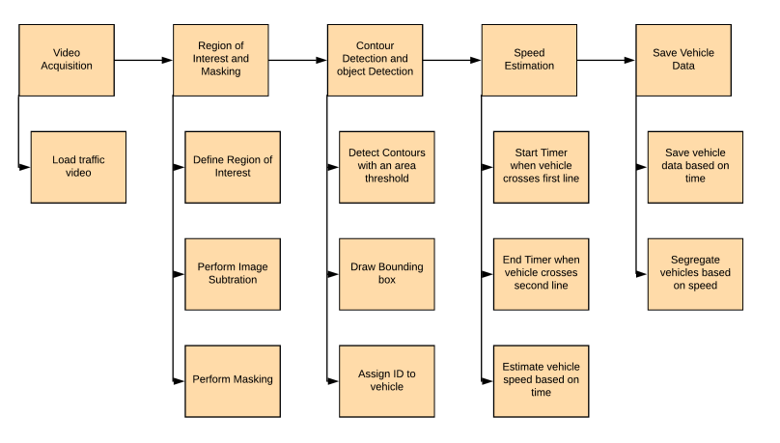
Project Model

Slide 13
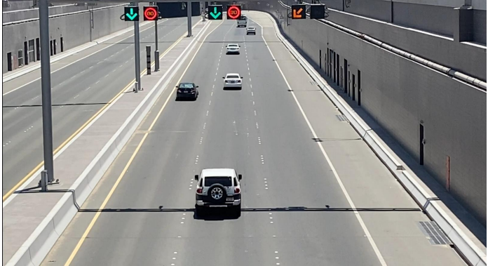
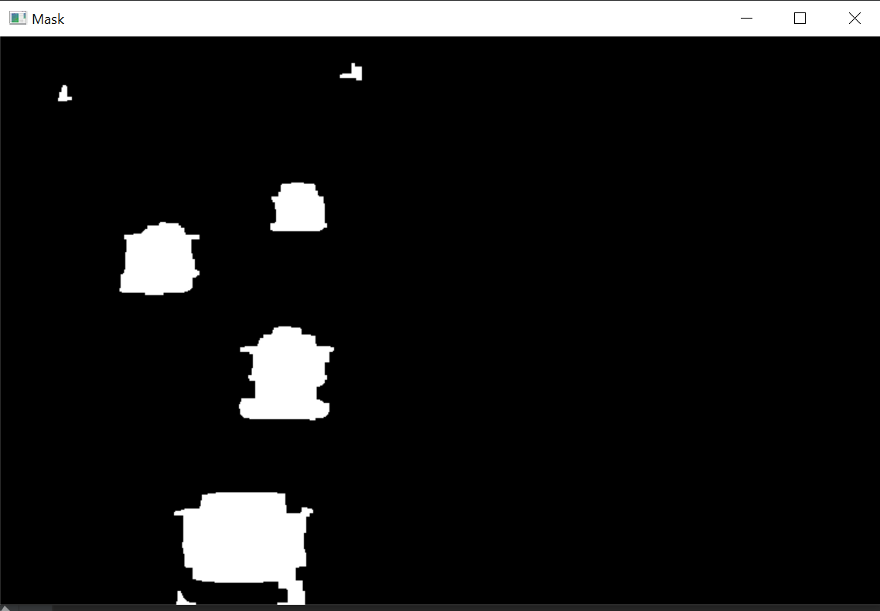
Project Model - Object Tracking
DETECT CONTOURS
OBJECT TRACKER
ELIMINATE
BASED ON AREA

Slide 14
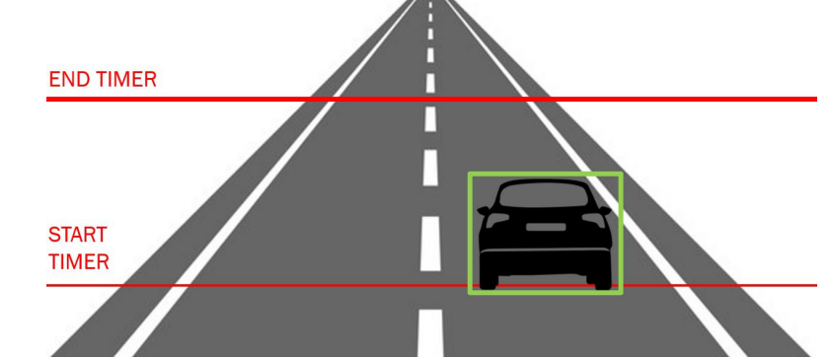
Speed Estimation

Slide 15
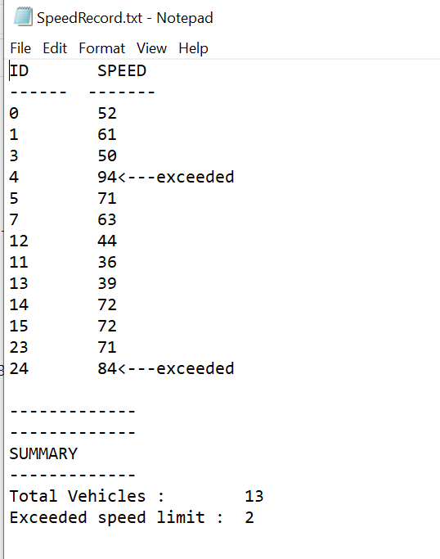


Save Vehicle Data
TRAFFIC RECORDS

Slide 16
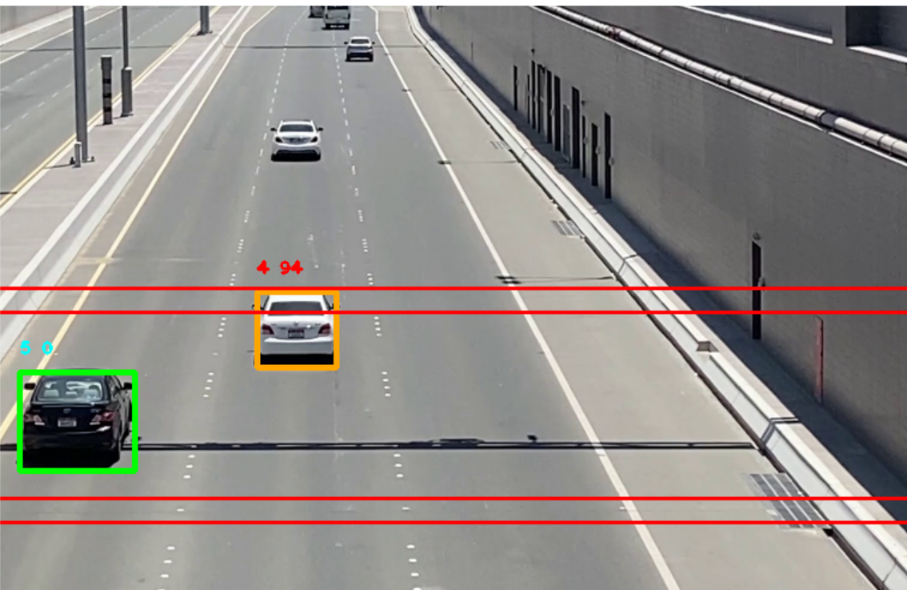
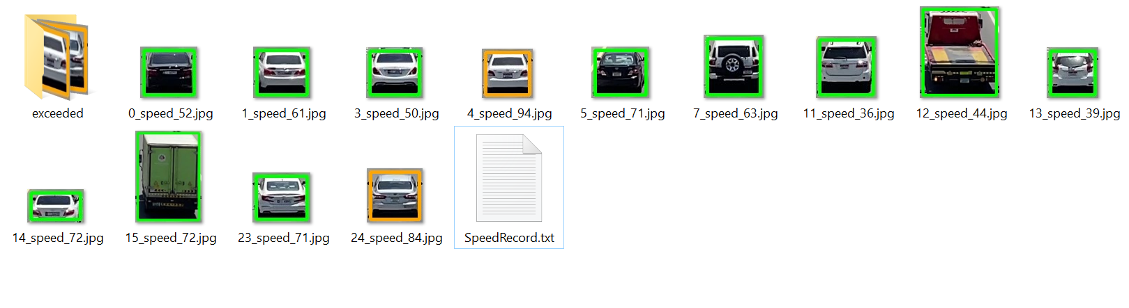
Results
4.Hourly:

Slide 17
Project Challenges And Updates
Objects that weren’t vehicles were being detected
This was sorted by changing the masking method.
Number Plates Unreadable
Pictures of vehicles were stored instead.
Multiple vehicles speeds were unable to be detected
This was sorted by saving speed timers in an array format instead of an single integer format
Vehicles close together were clubbed as single object
Eroded Masked Image to better differentiate close objects
Moved detection lines further back

Slide 18
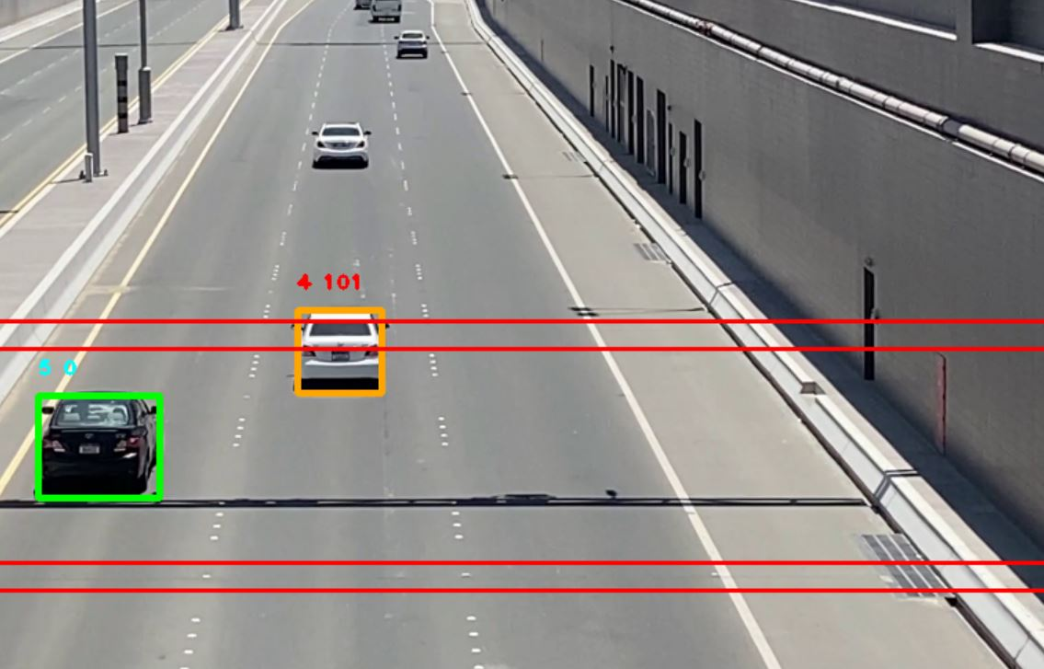
Video Link – YOU TUBE
https://www.youtube.com/watch?v=_FKGOXCwlWQ

Slide 19
References
Determining vehicle speed based on video using convolutional neural network
https://www.sciencedirect.com/science/article/pii/S2352146520307705
Detection of Vehicle Position and Speed using Camera Calibration and Image Projection Methods
https://www.sciencedirect.com/science/article/pii/S187705091931083X
Vehicle speed measurement model for video-based systems
https://www.sciencedirect.com/science/article/pii/S0045790618317774
An Efficient Approach for Detection and SpeedEstimation of Moving Vehicles
https://www.sciencedirect.com/science/article/pii/S1877050916311103

Slide 20
THANK YOU

